Slide 1

Building an OpenBSD Router
Using OpenBSD to make your perfect Firewall / Router.
presented by Yukaia and d3c4f

Slide 2
*new presentation warning*
fancy graphics have been skimped on :(

Slide 3


Slide 4
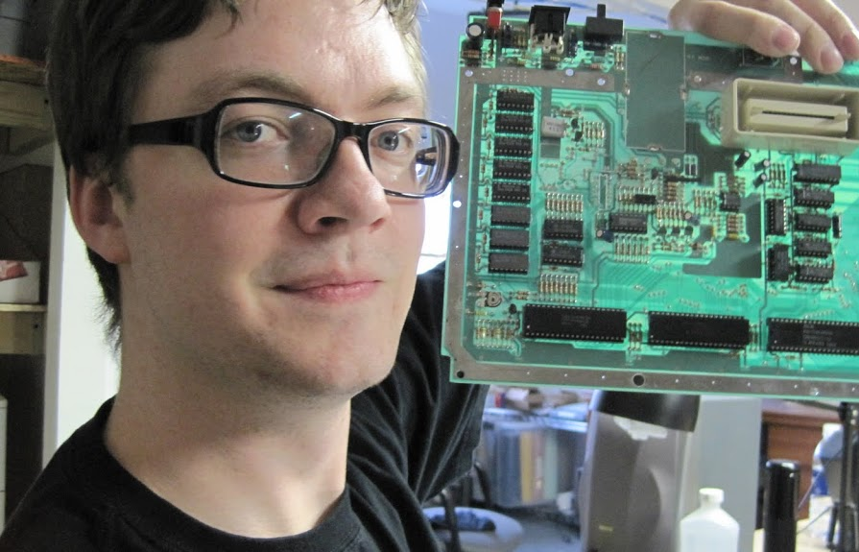

Who?
d3c4f
Systems Admin / DevOps
Software Developer
PortAParty Co-Creator
theTransistor Founder
OpenWest Core Team
BlackHat NOC Team
Caffeine Addict
Electronic Badge Designer
Yukaia
Systems Administrator
Automobile Enthusiast
PortAParty Co-Creator
theTransistor Founder
OpenWest Core Team
Blackhat NOC Team
Dr.Pepper Connoisseur
Hardware / Server Nerd

Slide 5
Contact Info>
d3c4f@sausage.land
yukaia@sausage.land

Slide 6
What will we be talking about today?
Why? (why build your own router?, why use OpenBSD?)
Hardware Requirements
Installing OpenBSD (a very brief outline)
Configuring the OS
Configuring your DHCP Server
Configuring your DNS Server
Configuring PF
Monitoring your traffic / OS / etc.
Future Updates to your new Router / Firewall

Slide 7
Why?
Why not use a commercial router?
Why not use OPNSense / PFSense / Etc?

Slide 8


Slide 9
Why not use a commercial router?

Slide 10
Why not use a commercial router?
Poor updates.
Seriously, how often did you update your LinkSys firmware?
Updates are always WAY behind the actual distro / BSD they are running on.

Slide 11
Why not use a commercial router?
Poor updates.
Seriously, how often did you update your LinkSys firmware?
Updates are always WAY behind the actual distro / BSD they are running on.
Weak hardware.
Most Home / Small business routers have very limited resources.
When you build your own, you can scale to the size you need.

Slide 12
Why not use a commercial router?
Poor updates.
Seriously, how often did you update your LinkSys firmware?
Updates are always WAY behind the actual distro / BSD they are running on.
Weak hardware.
Most Home / Small business routers have very limited resources.
When you build your own, you can scale to the size you need.
Poor interfaces / Mystery Meat
What is it ACTUALLY doing when you click that?

Slide 13
Why not use a commercial router?
Poor updates.
Seriously, how often did you update your LinkSys firmware?
Updates are always WAY behind the actual distro / BSD they are running on.
Weak hardware.
Most Home / Small business routers have very limited resources.
When you build your own, you can scale to the size you need.
Poor interfaces / Mystery Meat.
What is it ACTUALLY doing when you click that?
Poor (or non-existent) Logging / Debugging
DNS / DHCP / Traffic / Hardware Resource Utilization

Slide 14
Why not use a commercial router?
Poor updates.
Seriously, how often did you update your LinkSys firmware?
Updates are always WAY behind the actual distro / BSD they are running on.
Weak hardware.
Most Home / Small business routers have very limited resources.
When you build your own, you can scale to the size you need.
Poor interfaces / Mystery Meat.
What is it ACTUALLY doing when you click that?
Poor (or non-existent) Logging / Debugging
DNS / DHCP / Traffic / Hardware Resource Utilization
Lack of customization
DHCP Options? Caching DNS / Traffic? etc.

Slide 15
Why not use a commercial router?
Security (aside from Updates / Logging / etc)

Slide 16
Why not use a commercial router?
Security (aside from Updates / Logging / etc)
No IDS / IPS available (usually)

Slide 17
Why not use a commercial router?
Security (aside from Updates / Logging / etc)
No IDS / IPS available (usually)
Backdoors. That’s right, your commercial router is almost certainly backdoored. And don’t think the vendor is the only one with knowledge of this.
https://tech.slashdot.org/story/14/04/22/001239/intentional-backdoor-in-consumer-routers-found
http://securityaffairs.co/wordpress/20941/hacking/netgear-linkys-routers-backdoor.html
https://www.wired.com/2013/09/nsa-router-hacking/
https://www.wired.com/2015/12/juniper-networks-hidden-backdoors-show-the-risk-of-government-backdoors

Slide 18
Why not use OPNSense / PFSense / etc?

Slide 19
Why not use OPNSense / PFSense / etc?
Not a bad option at all!
Gives you a simple / quick interface to make common changes
We actually REALLY like OPNSense!

Slide 20
Why not use OPNSense / PFSense / etc?
Not a bad option at all!
Gives you a simple / quick interface to make common changes
We actually REALLY like OPNSense!
Granularity / Customization / Freedom
Maybe you want to know what is actually happening on the backend
Maybe you want to install a feature / package / tool that isn’t available
Maybe you don’t like GUIs
Maybe you want SQUEEZE every ounce of performance from your hardware
Maybe you want to learn more about OpenBSD / PF / etc.

Slide 21
Why OpenBSD?

Slide 22
Why OpenBSD?
SOLID network stack

Slide 23
Why OpenBSD?
SOLID network stack
Awesome security

Slide 24
Why OpenBSD?
SOLID network stack
Awesome security
PF (Packet Filter - Traffic Filtering, NAT/PAT, QoS, and more!)

Slide 25
Why OpenBSD?
SOLID network stack
Awesome security
PF (Packet Filter - Traffic Filtering, NAT/PAT, QoS, and more!)
Stability!

Slide 26
Why OpenBSD?
SOLID network stack
Awesome security
PF (Packet Filter - Traffic Filtering, NAT/PAT, QoS, and more!)
Stability!
...and more

Slide 27
Hardware

Slide 28
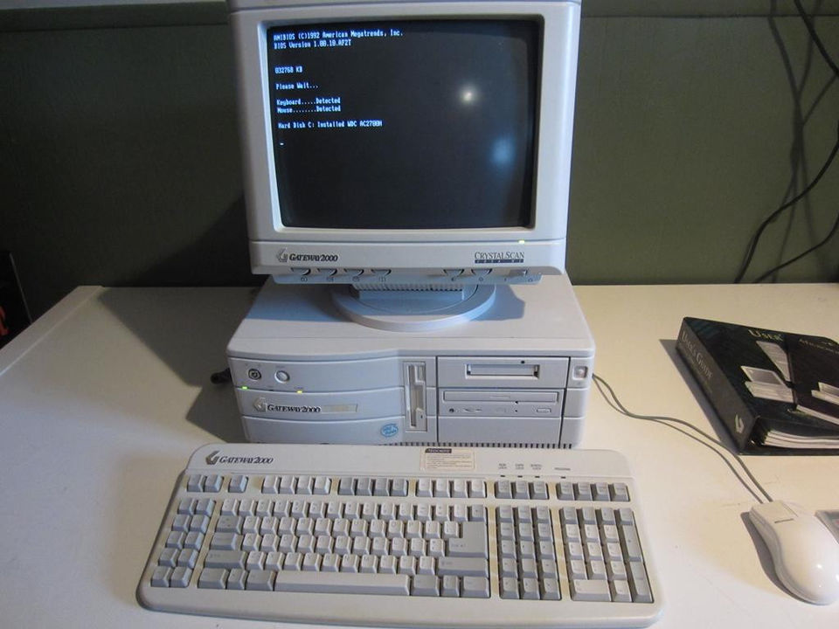
Hardware
Minimum Requirements

Slide 29
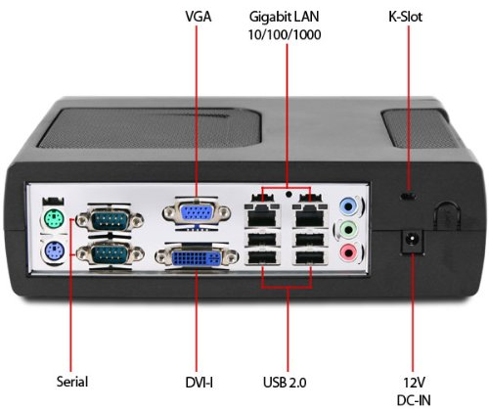
Hardware
Recommended Minimums
Dual Core Atom 800mhz
1GB DDR3
At least 2x 100Mbps NICs
Verify that the chipset is supported
100 GB Disk Space
Spindle Disks will work great
Low Power / Low Noise is a Plus :)
A managed network switch is always nice
But not required, by any means

Slide 30
Installing OpenBSD

Slide 31

Installing OpenBSD

Slide 32

Installing OpenBSD

Slide 33
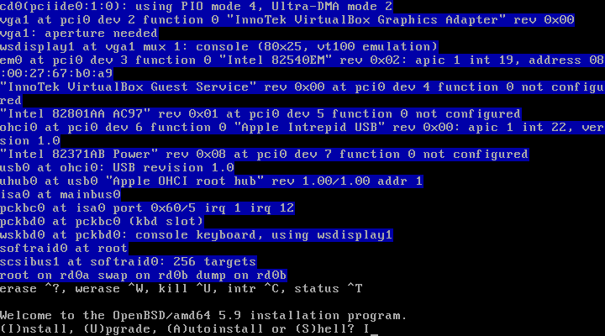

Slide 34
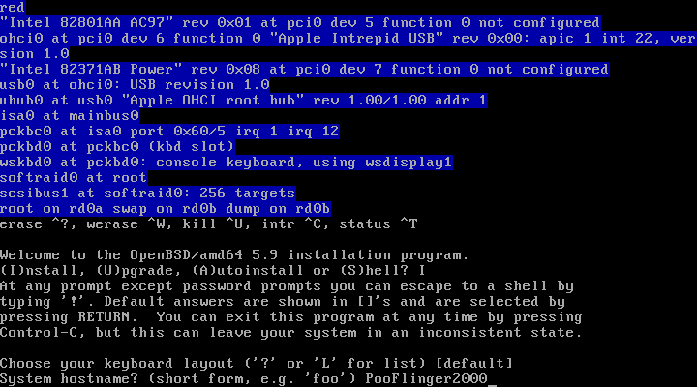

Slide 35
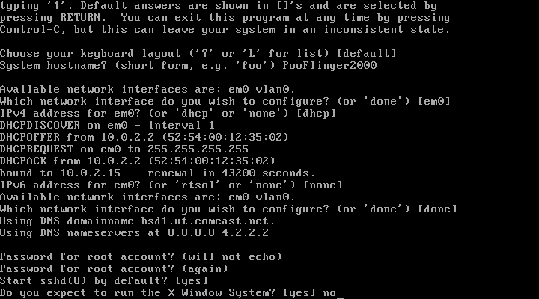

Slide 36
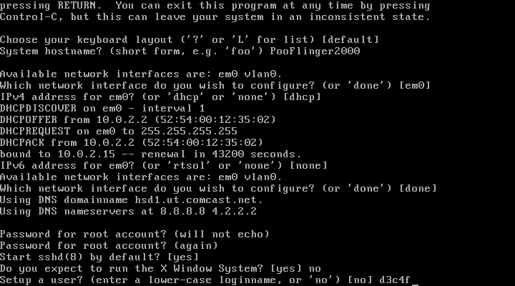

Slide 37
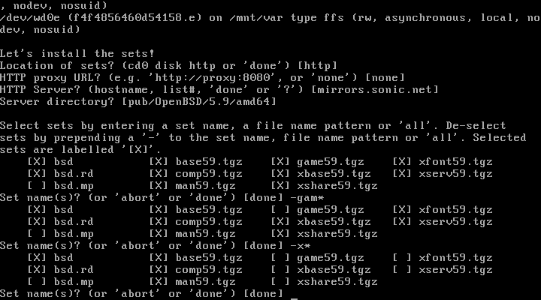

Slide 38
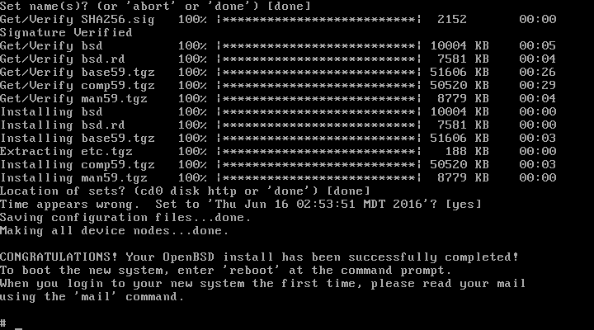

Slide 39
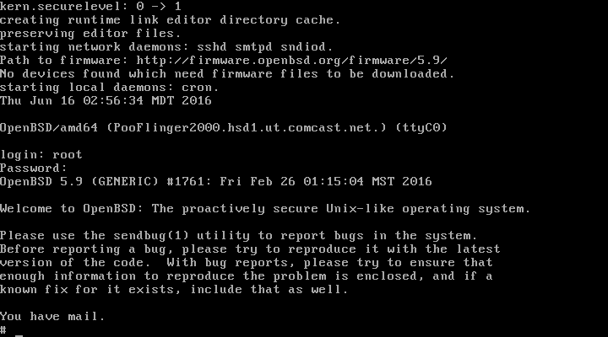

Slide 40
Configuring the OpenBSD Operating System
Install packages

Slide 41
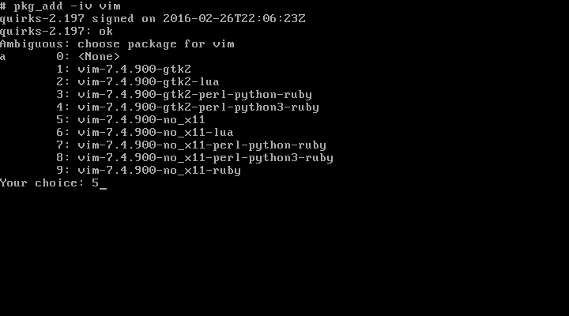

Slide 42


Slide 43


Slide 44
Configuring the OpenBSD Operating System
Install packages
Kernel Module - Enable routing

Slide 45
net.inet.ip.forwarding=1
# vim /etc/sysctl.conf

Slide 46
Configuring the OpenBSD Operating System
Install packages
Kernel Module - Enable routing
Setup Network Interfaces

Slide 47
dhcp
# vim /etc/hostname.em0

Slide 48
inet 10.10.10.1 255.255.255.0 10.10.10.255
# vim /etc/hostname.em1

Slide 49
Configuring DHCP Daemon
Make DHCPD start on boot

Slide 50
dhcp_flags=””
# vim /etc/rc.conf.local

Slide 51
Configuring DHCP Daemon
Make DHCPD start on boot
Configure DHCPD options

Slide 52
subnet 10.10.10.0 netmask 255.255.255.0
{
default-lease-time 604800;
option domain-name “PooFlinger2000”;
option domain-name-servers 4.2.2.2, 4.4.4.4;
option routers 10.10.10.1;
option subnet-mask 255.255.255.0;
option broadcast-address 10.10.10.255;
range 10.10.10.50 10.10.10.254;
}
# vim /etc/dhcpd.conf

Slide 53
Configuring DNSMasq
Make DNSMasq start on boot

Slide 54
if [ -x /usr/local/sbin/dnsmasq ]; then
echo ‘ starting: dnsmasq ‘; /usr/local/sbin/dnsmasq
fi
# vim /etc/rc.local

Slide 55
Configuring DNSMasq
Make DNSMasq start on boot
Configure DNSMasq options

Slide 56
no-poll
no-resolv
no-hosts
server=75.75.75.75
server=8.8.8.8
cache-size=9001
local-ttl=90
auth-ttl=120
max-ttl=90
max-cache-ttl=90
log-queries
log-facility=/var/log/dnsmasq_queries.log
# LOCAL DNS REWRITES
address=/bing.com/10.10.10.5
address=/.bing.com/10.10.10.5
# vim /etc/dnsmasq.conf

Slide 57
Configuring PF
Make PF start on boot
(It already does!)

Slide 58
Configuring PF
Make PF start on boot
(It already does!)
Configure PF

Slide 59
set limit states 1000000 # one million states! Bwahahaha
set skip on lo0 # skip processing on loopback device
match out on em0 inet from em1:network nat-to (em0) # enable NAT
block quick inet6 # kill all IPv6 traffic. Dead. Bam.
block all # default block rule. no “quick” so last matching rule wins
pass from { self, em1:network }
# rewrite DNS requests to local DNSMasq Service
pass in quick on em1 proto udp from any to port 53 \
rdr-to 127.0.0.1 tag dns
pass inet proto icmp icmp-type echoreq # allow ping requests
# Allow external->internal SSH from tcp port 2222, translated to tcp port 22
pass in on egress inet proto tcp from any to (egress) port 2222 \
rdr-to 10.10.10.5 port 22
# vim /etc/pf.conf

Slide 60
Monitoring your new firewall / router
CPU / Memory Utilization
TOP
HTOP

Slide 61
Monitoring your new firewall / router
CPU / Memory Utilization
TOP
HTOP
Network
IFTOP
NLOAD
VNSTAT
System stats
Collectd / Grafana

Slide 62
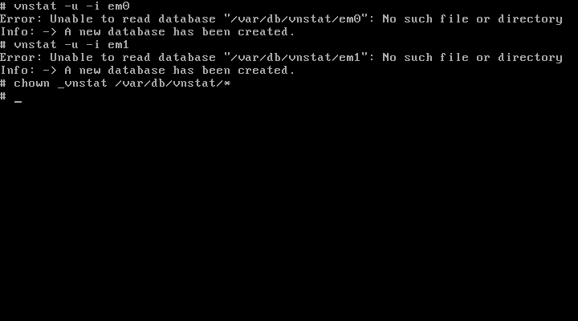

Slide 63
dhcpd_flags=””
pkg_scripts=”vnstatd”
# vim /etc/rc.conf.local

Slide 64
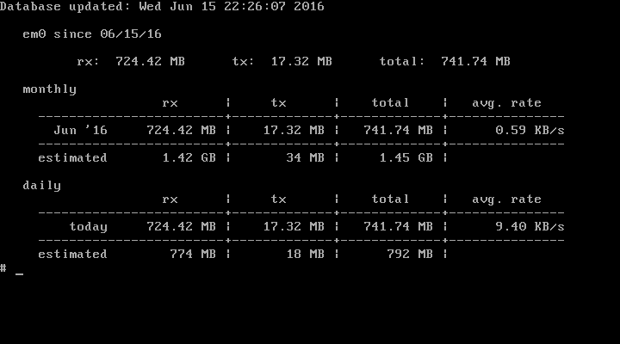

Slide 65
Monitoring your new firewall / router
CPU / Memory Utilization
TOP
HTOP
Network
IFTOP
NLOAD
VNSTAT
System stats
Collectd / Grafana
DHCP Leases
tail -f /var/db/dhcpd.leases

Slide 66
Monitoring your new firewall / router
CPU / Memory Utilization
TOP
HTOP
Network
IFTOP
NLOAD
VNSTAT
System stats
Collectd / Grafana
DHCP Leases
tail -f /var/db/dhcpd.leases
DNS Queries
tail -f /var/log/dnsmasq_queries.log

Slide 67
Monitoring your new firewall / router
CPU / Memory Utilization
TOP
HTOP
Network
IFTOP
NLOAD
VNSTAT
System stats
Collectd / Grafana
DHCP Leases
tail -f /var/db/dhcpd.leases
DNS Queries
tail -f /var/log/dnsmasq_queries.log
PF Information
pfctl -ss ; pfcfl -si ; pfctl -sr

Slide 68


Slide 69
Future updates to consider
QoS (Quality of Service)
SUPER easy to implement via PF

Slide 70
Future updates to consider
QoS (Quality of Service)
SUPER easy to implement via PF
IDS / IPS / “NextGen Firewall” options
SNORT / OpenAppID
Suricata

Slide 71
Future updates to consider
QoS (Quality of Service)
SUPER easy to implement via PF
IDS / IPS / “NextGen Firewall” options
SNORT / OpenAppID
Suricata
Redundancy / Failover
CARP / PFSync

Slide 72
Future updates to consider
QoS (Quality of Service)
SUPER easy to implement via PF
IDS / IPS / “NextGen Firewall” options
SNORT / OpenAppID
Suricata
Redundancy / Failover
CARP / PFSync
...and whatever else you can think of.

Slide 73
Thanks for coming!
Please ask any questions now, before we escape!

